Slide 1
UNIT 3
Scale and Measurement

Slide 2
REVISION

Slide 3
Unit-III
Scaling & measurement techniques: Concept of Measurement:
Levels of measurement – Nominal, Ordinal, Interval, Ratio.
Need of Measurement Problems in measurement in management research – Validity and Reliability.
Concept of Scale – Rating Scales viz. Likert Scales, Semantic Differential Scales, Constant Sum Scales, Graphic Rating Scales – Ranking Scales – Paired comparison & Forced Ranking – Concept and Application.

Slide 4

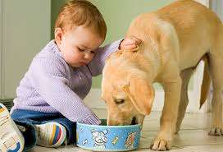

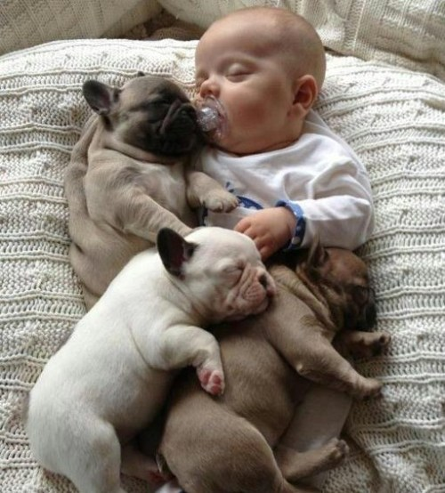

Slide 5
Scaling & measurement techniques: Concept of Measurement
Measurement is a process of mapping aspects of a domain onto other aspects of a range according to some rule of correspondence.
Measurement of absolute and abstract.
Weight, height, etc., can be measured directly with some standard unit of measurement.
measure
Motivation to succeed, ability to stand stress etc cannot be measured directly.

Slide 6
Levels of Measurement
The level of measurement determines which statistical calculations are meaningful. The four levels of measurement are: nominal, ordinal, interval, and ratio.
Nominal
Lowest to highest
Levels of Measurement
Ordinal
Interval
Ratio

Slide 7
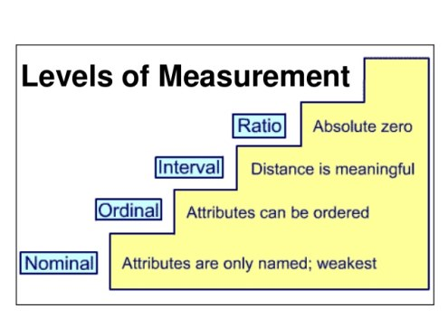

Slide 8
Nominal Level of Measurement
Data at the nominal level of measurement are qualitative only.
Nominal
Levels of Measurement
Calculated using names, labels, or qualities. No mathematical computations can be made at this level.
Colors in the US flag
Names of students in your class
Textbooks you are using this semester

Slide 9
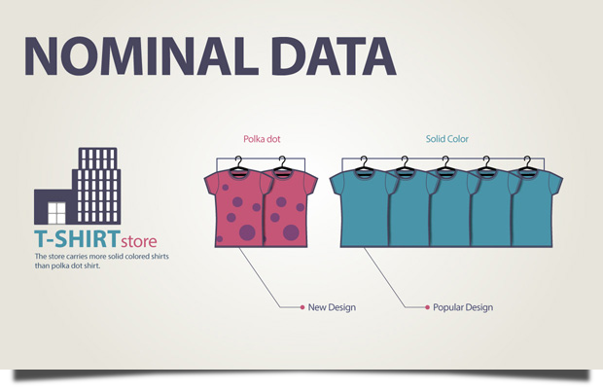

Slide 10
Ordinal Level of Measurement
Data at the ordinal level of measurement are qualitative or quantitative.
Levels of Measurement
Ordinal
Arranged in order, but differences between data entries are not meaningful.
Class standings: freshman, sophomore, junior, senior
Numbers on the back of each player’s shirt
Top 50 songs played on the radio

Slide 11
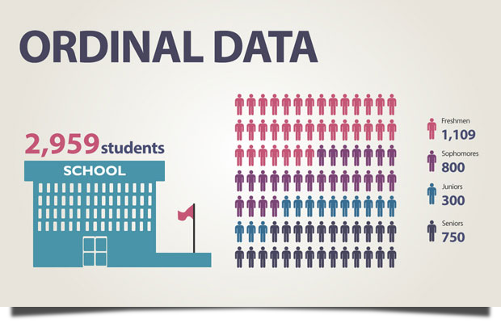

Slide 12
Interval Level of Measurement
Data at the interval level of measurement are quantitative. A zero entry simply represents a position on a scale; the entry is not an inherent zero.
Levels of Measurement
Interval
Arranged in order, the differences between data entries can be calculated.
Years on a timeline
Atlanta Braves World Series victories

Slide 13
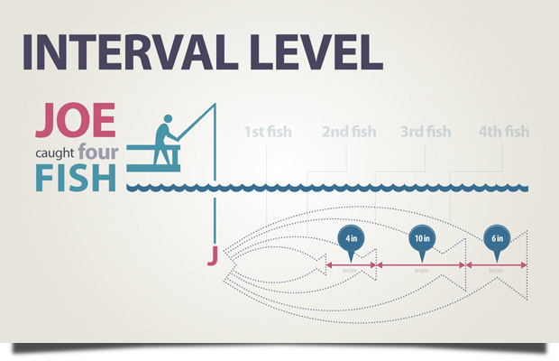

Slide 14
Ratio Level of Measurement
Data at the ratio level of measurement are similar to the interval level, but a zero entry is meaningful.
A ratio of two data values can be formed so one data value can be expressed as a ratio.
Levels of Measurement
Ratio
Ages
Grade point averages
Weights

Slide 15
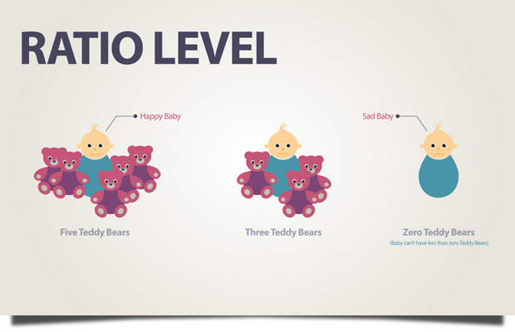

Slide 16
Summary of Levels of Measurement
Level of measurement
Put data in categories
Arrange data in order
Subtract data values
Determine if one data value is a multiple of another
Nominal
Yes
No
No
No
Ordinal
Yes
Yes
No
No
Interval
Yes
Yes
Yes
No
Ratio
Yes
Yes
Yes
Yes

Slide 17
Types of Scales – Review

Slide 18
Measure Development
Only after rigorous literature review & there is no quantitative scale suits your needs, then you can develop your own measurement scale. Some considerations include:
Ensure you develop your operational definition first for each variable & construct.
Use simple language & words for each questions & when all the questions group together should referring to one variable / construct.
Ensure there is no double / multi-barrels question i.e. a question ask more than 1 thing that respondents are confused not sure which thing the researcher is asking & when they responded, the researcher not sure which thing the respondents are answering (because too many things are asked in 1 question).

Slide 19
Measure Development
Ensure you use formative or reflective questions as appropriate to represent a variable or construct –
Formative questions are several questions in which each has its own unique attribute / characteristic & all questions group together to form / represent the variable.
Reflective questions refer to several questions whereby each question is reflecting a variable from different angle for several times.
Reason being formative / reflective questions can affect what data analysis modeling you need to use e.g. Partial Least Squares-Structural Equation Modeling (PLS-SEM) vs Covariance-based SEM etc.

Slide 20
Sources of Error
Respondent
Situation
Measurer
Instrument

Slide 21
Sources of Error
The ideal study should be designed and controlled for precise and unambiguous measurement of the variables. Since complete control is unattainable, error does occur. Much error is systematic (results from bias), while the remainder is random (occurs erratically).
Opinion differences that affect measurement come from relatively stable characteristics of the respondent such as employee status, ethnic group membership, social class, and gender.

Slide 22
Sources of Error _{continued}
Respondents may also suffer from temporary factors like fatigue and boredom.
Any condition that places a strain on the interview or measurement session can have serious effects on the interviewer-respondent rapport.
The interviewer can distort responses by rewording, paraphrasing, or reordering questions. Stereotypes in appearance and action also introduce bias. Careless mechanical processing will distort findings and can also introduce problems in the data analysis stage through incorrect coding, careless tabulation, and faulty statistical calculation.
A defective instrument can cause distortion in two ways. First, it can be too confusing and ambiguous. Second, it may not explore all the potentially important issues.

Slide 23
Sources of Error
The interviewer can distort responses by rewording, paraphrasing, or reordering questions. Stereotypes in appearance and action also introduce bias. Careless mechanical processing will distort findings and can also introduce problems in the data analysis stage through incorrect coding, careless tabulation, and faulty statistical calculation.
A defective instrument can cause distortion in two ways:
First, it can be too confusing and ambiguous.
Second, it may not explore all the potentially important issues.

Slide 24
Evaluating Measurement Tools
What are the characteristics of a good measurement tool?
A tool should be an accurate indicator of what one needs to measure.
It should be easy and efficient to use.
There are three major criteria for evaluating a measurement tool.
Validity is the extent to which a test measures what we actually wish to measure.
Reliability refers to the accuracy and precision of a measurement procedure.
Practicality is concerned with a wide range of factors of economy, convenience, and interpretability.

Slide 25
Evaluating Measurement Tools
Validity
Criteria
Practicality
Reliability

Slide 26
Validity Determinants
Content
Criterion
Construct

Slide 27
Validity Determinants

Slide 28
Validity Determinants
There are three major forms of validity:
Content validity refers to the extent to which measurement scales provide adequate coverage of the investigative questions.
If the instrument contains a representative sample of the universe of subject matter of interest, then content validity is good.
To evaluate content validity, one must first agree on what elements constitute adequate coverage.
To determine content validity, one may use one’s own judgment and the judgment of a panel of experts.

Slide 29
Increasing Content Validity
Content
Question Database
Literature Search
Expert Interviews
Group Interviews

Slide 30
Validity Determinants
Criterion-related validity-reflects the success of measures used for prediction or estimation.
There are two types of criterion-related validity: concurrent and predictive .
These differ only on the time perspective. An attitude scale that correctly forecasts the outcome of a purchase decision has predictive validity. An observational method that correctly categorizes families by current income class has concurrent validity.

Slide 31
Validity Determinants
Construct validity is a measurement scale that demonstrates both convergent validity and discriminant validity.
In attempting to evaluate construct validity, one considers both the theory and measurement instrument being used.
For instance, suppose we wanted to measure the effect of trust in relationship marketing. We would begin by correlating results obtained from our measure with those obtained from an established measure of trust. To the extent that the results were correlated, we would have indications of convergent validity. We could then correlate our results with the results of known measures of similar, but different measures such as empathy and reciprocity. To the extent that the results are not correlated, we can say we have shown discriminant validity.

Slide 32
Reliability Estimates
Stability
Internal
Consistency
Equivalence

Slide 33
Reliability Estimates
A measure is reliable to the degree that it supplies consistent results.
Reliability is a necessary contributor to validity but is not a sufficient condition for validity.
It is concerned with estimates of the degree to which a measurement is free of random or unstable error.
Reliable instruments are robust and work well at different times under different conditions. This distinction of time and condition is the basis for three perspectives on reliability – stability, equivalence, and internal consistency

Slide 34
Reliability Estimates
A measure is said to possess stability, if one can secure consistent results with repeated measurements of the same person with the same instrument.
Test-retest (comparisons of two tests to learn how reliable they are) can be used to assess stability.
A correlation between the two tests indicates the degree of stability.

Slide 35
Reliability Estimates
Stability
Internal
Consistency
Equivalence

Slide 36
Reliability Estimate
Equivalence is concerned with variations at one point in time among observers and samples of items.
A good way to test for the equivalence of measurements by different observers is to compare their scoring of the same event.
One tests for item sample equivalence by using alternate or parallel forms of the same test administered to the same persons simultaneously. The results of the two tests are then correlated. When a time interval exists between the two tests, the approach is called delayed equivalent forms.

Slide 37
Reliability Estimates

Slide 38
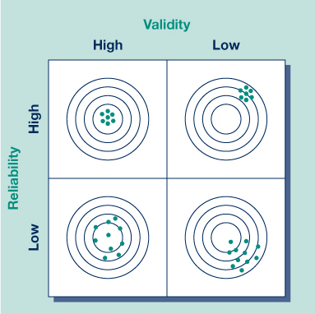
Understanding Validity and Reliability

Slide 39
Practicality
Economy
Convenience
Interpretability

Slide 40
Practicality
The scientific requirements of a project call for the measurement process to be reliable and valid, while the operational requirements call for it to be practical.
Practicality has been defined as economy, convenience, and interpretability. There is generally a trade-off between the ideal research project and the budget.
A measuring device passes the convenience test if it is easy to administer.
The interpretability aspect of practicality is relevant when persons other than the test designers must interpret the results. In such cases, the designer of the data collection instrument provides several key pieces of information to make interpretation possible.

Slide 41
Sensitivity
Sensitivity – Sensitivity is the ability of a measurement instrument to accurately measure variability in stimuli or responses (e.g. on a scale, the choices very strongly agree, strongly agree, agree, don’t agree offer more choices than a scale with just two choices - agree and don’t agree – and is thus more sensitive)

Slide 42
Attitude
Measuring Attitude is a frequent undertaking in business research
Attitude may be defined as an enduring disposition to consistently respond in a given manner to various aspects
An attitude is a learned, stable predisposition to respond to oneself, other persons, objects, or issues in a consistently favorable or unfavorable way.
Attitudes can be expressed or based cognitively, affectively, and behaviorally.

Slide 43
Components of Attitude
Affective Component – Reflective of a person’s general feelings or emotions towards an object or subject (like, dislike, love, hate)
Cognitive Component – Reflective of a person’s awareness of and knowledge about an object or subject (know, believe)
Behavioral Component – Reflective of a person’s intentions and behavioral expectations, and predisposition to action

Slide 44

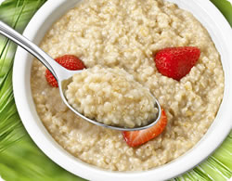
Nature of Attitudes
Cognitive
I think oatmeal is healthier
than corn flakes for breakfast.
Affective
I hate corn flakes.
Behavioral
I intend to eat more oatmeal
for breakfast.

Slide 45
Selecting a Measurement Scale
Attitude scaling is the process of assessing an attitudinal disposition using a number that represents a person’s score on an attitudinal continuum ranging from an extremely favorable disposition to an extremely unfavorable one.
Scaling is the procedure for the assignment of numbers to a property of objects in order to impart some of the characteristics of numbers to the properties in question.
Selecting and constructing a measurement scale requires the consideration of several factors that influence the reliability, validity, and practicality of the scale.

Slide 46
Selecting a Measurement Scale
Researchers face two types of scaling objectives:
to measure characteristics of the participants who participate in the study, and
to use participants as judges of the objects or indicants presented to them.
Measurement scales fall into one of four general response types: rating, ranking, categorization, and sorting.
Decisions about the choice of measurement scales are often made with regard to the data properties generated by each scale: nominal, ordinal, interval, and ratio.

Slide 47
Response Types
Rating scale
Ranking scale
Categorization
Sorting

Slide 48
Response Types
A rating scale is used when participants score an object or indicant without making a direct comparison to another object or attitude. For example, they may be asked to evaluate the styling of a new car on a 7-point rating scale.
Ranking scale constrain the study participant to making comparisons and determining order among two or more properties or objects. Participants may be asked to choose which one of a pair of cars has more attractive styling. A choice scale requires that participants choose one alternative over another. They could also be asked to rank-order the importance of comfort, ergonomics, performance, and price for the target vehicle.

Slide 49
Response Types
Categorization asks participants to put themselves or property indicants in groups or categories.
Sorting requires that participants sort card into piles using criteria established by the researcher. The cards might contain photos or images or verbal statements of product features such as various descriptors of the car’s performance.

Slide 50

Number of Dimensions
Unidimensional
Multi-dimensional

Slide 51
Number of Dimensions
With a unidimensional scale, one seeks to measure only one attribute of the participant or object. One measure of an actor’s star power is his or her ability to “carry” a movie. It is a single dimension.
A multidimensional scale recognizes that an object might be better described with several dimensions. The actor’s star power variable might be better expressed by three distinct dimensions - ticket sales for the last three movies, speed of attracting financial resources, and column-inch/amount of TV coverage of the last three movies.

Slide 52
Balanced or Unbalanced
A balanced rating scale has an equal number of categories above and below the midpoint.
Scales can be balanced with or without a midpoint option.
How good an actress is Angelina Jolie?
Very bad
Bad
Neither good nor bad
Good
Very good
Poor
Fair
Good
Very good
Excellent
An unbalanced rating scale has an unequal number of favorable and unfavorable response choices.

Slide 53
Forced or Unforced Choices
An unforced-choice rating scale provides participants with an opportunity to express no opinion when they are unable to make a choice among the alternatives offered.
Very bad
Bad
Neither good nor bad
Good
Very good
Very bad
Bad
Neither good nor bad
Good
Very good
No opinion
Don’t know
A forced-choice scale requires that participants select one of the offered alternatives

Slide 54
Rating Techniques to Measure Attitude
Rating Scales are frequently employed in business research for measuring attitude, and many scales have been developed for this purpose, including:
Simple Attitude Scales
Category Scales
Likert Scale
Semantic Differential
Numerical Scales
Constant-Sum Scale
Stapel Scale
Graphic Scales

Slide 55
Simple Attitude Scales
In attitude scaling, individuals are typically asked whether they agree or disagree with a question (or questions) put to them, or they are asked to respond to a question or questions
Simple attitude scales have the properties of a nominal scale and the disadvantages that go with it, also, they do not permit fine distinctions in the respondents’ answers because their choice of answers is limited, but they can be useful in instances where the respondents’ education level is low and questionnaires lengthy

Slide 56
Category Scales
A category scale consists of several response categories to provide the respondent with alternative ratings
Category scales are more sensitive than rating scales which allow only two answer categories (because of the larger number of choices), and thus provides more data and information

Slide 57

Simple Category Scale
I plan to purchase a MindWriter laptop in the
12 months.
Yes
No
This scale is also called a dichotomous scale.
It offers two mutually exclusive response choices.
could be other response choices too such as agree and disagree.

Slide 58

Multiple-Choice, Single-Response Scale
What newspaper do you read most often for financial news?
East City Gazette
West City Tribune
Regional newspaper
National newspaper
Other (specify:_____________)

Slide 59

Multiple-Choice, Multiple-Response Scale
What sources did you use when designing your new
home? Please check all that apply.
Online planning services
Magazines
Independent contractor/builder
Designer
Architect
Other (specify:_____________)

Slide 60
The Likert Scale
A likert Scale is a measure of attitudes designed to allow respondents to indicate how strongly they agree or disagree with carefully constructed statements that range from very positive to very negative towards an object or subject
The number of alternatives on the Likert scale can vary, often five alternatives are foreseen (see text book examples)
A Likert Scale may include a number of question items, each covering some aspect of the respondent’s attitude, and these items collectively form an index

Slide 61

Likert Scale
The Internet is superior to traditional libraries for
comprehensive searches.
Strongly disagree
Disagree
Neither agree nor disagree
Agree
Strongly agree

Slide 62
The Likert Scale
The Likert scale was developed by Rensis Likert and is the most frequently used variation of the summated rating scale.
Summated rating scales consist of statements that express either a favorable or unfavorable attitude toward the object of interest.
The participant is asked to agree or disagree with each statement.
Each response is given a numerical score to reflect its degree of attitudinal favorableness and the scores may be summed to measure the participant’s overall attitude.
Likert-like scales may use 7 or 9 scale points.
They are quick and easy to construct.
The scale produces interval data.
Researchers have found that a larger number of items for each attitude object improves the reliability of the scale.

Slide 63
The Semantic Differential
The semantic differential is an attitude measuring technique that consists of a series of seven bi-polar rating scales which allow response to a concept (e.g. organization, product, service, job)
An advantage of the semantic differential is its versatility, on the other hand, it uses extremes which may influence respondents’ answers

Slide 64

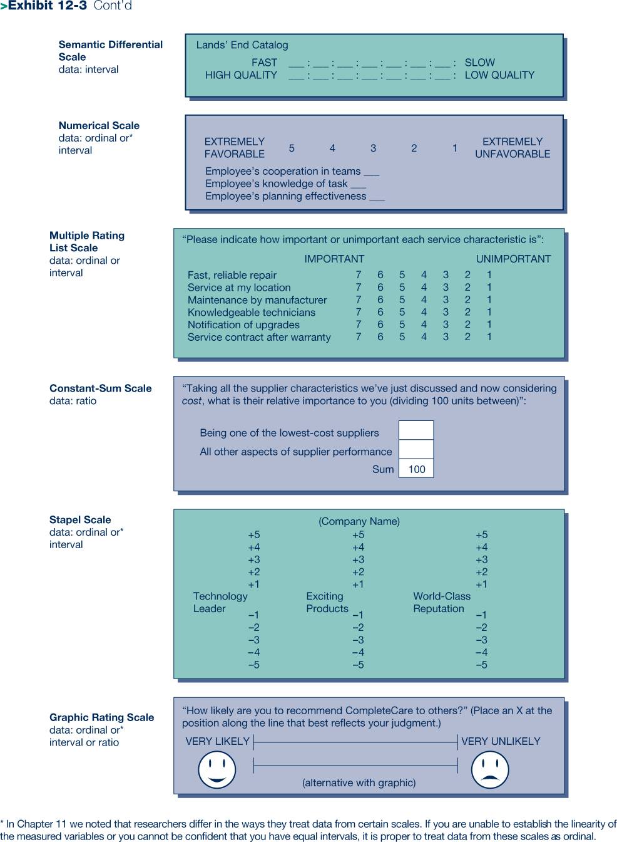
Semantic Differential

Slide 65
The Semantic Differential
The semantic differential scale measures the psychological meanings of an attitude object using bipolar adjectives.
Researchers use this scale for studies of brand and institutional image, employee morale, safety, financial soundness, trust, etc.
The method consists of a set of bipolar rating scales, usually with 7 points, by which one or more participants rate one or more concepts on each scale item.
The scale is based on the proposition that an object can have several dimensions of connotative meaning. The meanings are located in multidimensional property space, called semantic space.
The semantic differential scale is efficient and easy for securing attitudes from a large sample. Attitudes may be measured in both direction and intensity. The total set of responses provides a comprehensive picture of the meaning of an object and a measure of the person doing the rating. It is standardized and produces interval data.

Slide 66
Adapting SD Scales
Convenience of Reaching the Store from Your Location
Nearby | ___: ___: ___: ___: ___: ___: ___: | Distant
Short time required to reach store | ___: ___: ___: ___: ___: ___: ___: | Long time required to reach store
Difficult drive | ___: ___: ___: ___: ___: ___: ___: | Easy Drive
Difficult to find parking place | ___: ___: ___: ___: ___: ___: ___: | Easy to find parking place
Convenient to other stores I shop | ___: ___: ___: ___: ___: ___: ___: | Inconvenient to other stores I shop
Products offered
Wide selection of different kinds of products | ___: ___: ___: ___: ___: ___: ___: | Limited selection of different kinds of products
Fully stocked | ___: ___: ___: ___: ___: ___: ___: | Understocked
Undependable products | ___: ___: ___: ___: ___: ___: ___: | Dependable products
High quality | ___: ___: ___: ___: ___: ___: ___: | Low quality
Numerous brands | ___: ___: ___: ___: ___: ___: ___: | Few brands
Unknown brands | ___: ___: ___: ___: ___: ___: ___: | Well-known brands

Slide 67
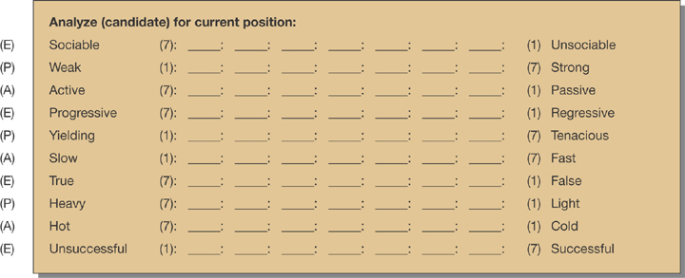
SD Scale for Analyzing Actor Candidates
A scale used by a consulting firm to help a movie production company evaluate actors for the leading role of a risky film venture. The selection of concepts is driven by the characteristics they believe the actor must possess to produce box office financial targets

Slide 68
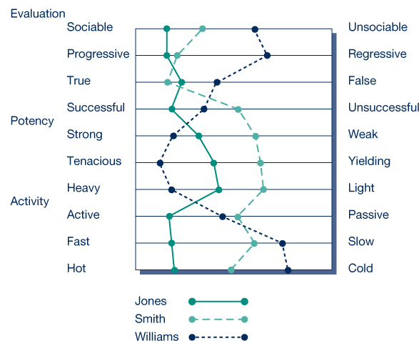
Graphic of SD Analysis

Slide 69
Numerical Scale
Numerical scales have equal intervals that separate their numeric scale points. The verbal anchors serve as the labels for the extreme points.
Numerical scales are often 5-point scales but may have 7 or 10 points.
The participants write a number from the scale next to each item.
It produces either ordinal or interval data.

Slide 70
Multiple Rating List Scales
A multiple rating scale is similar to the numerical scale but differs in two ways:
it accepts a circled response from the rater, and
the layout facilitates visualization of the results.
The advantage is that a mental map of the participant’s evaluations is evident to both the rater and the researcher.
This scale produces interval data.
“Please indicate how important or unimportant each service characteristic is:”
IMPORTANT UNIMPORTANT
Fast, reliable repair 7 6 5 4 3 2 1
Service at my location 7 6 5 4 3 2 1
Maintenance by manufacturer 7 6 5 4 3 2 1
Knowledgeable technicians 7 6 5 4 3 2 1
Notification of upgrades 7 6 5 4 3 2 1
Service contract after warranty 7 6 5 4 3 2 1

Slide 71
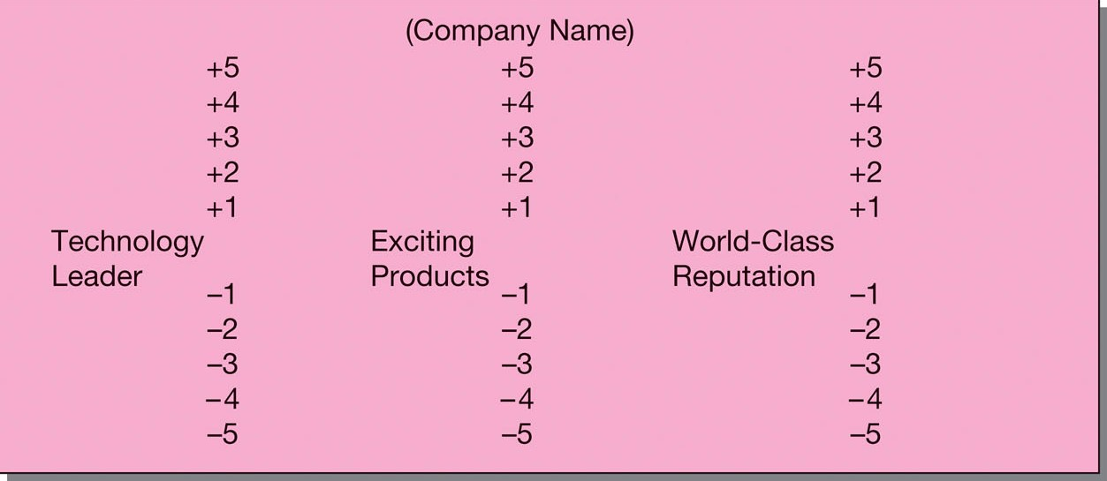
Stapel Scales

Slide 72

Constant-Sum Scales

Slide 73

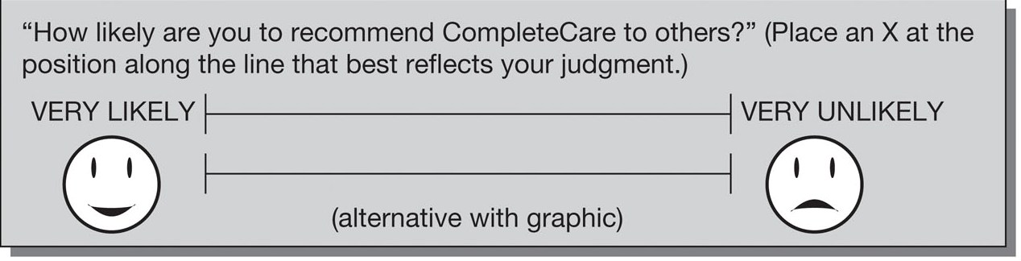
Graphic Rating Scales

Slide 74

Ranking Scales
Paired-comparison scale
Forced ranking scale
Comparative scale

Slide 75

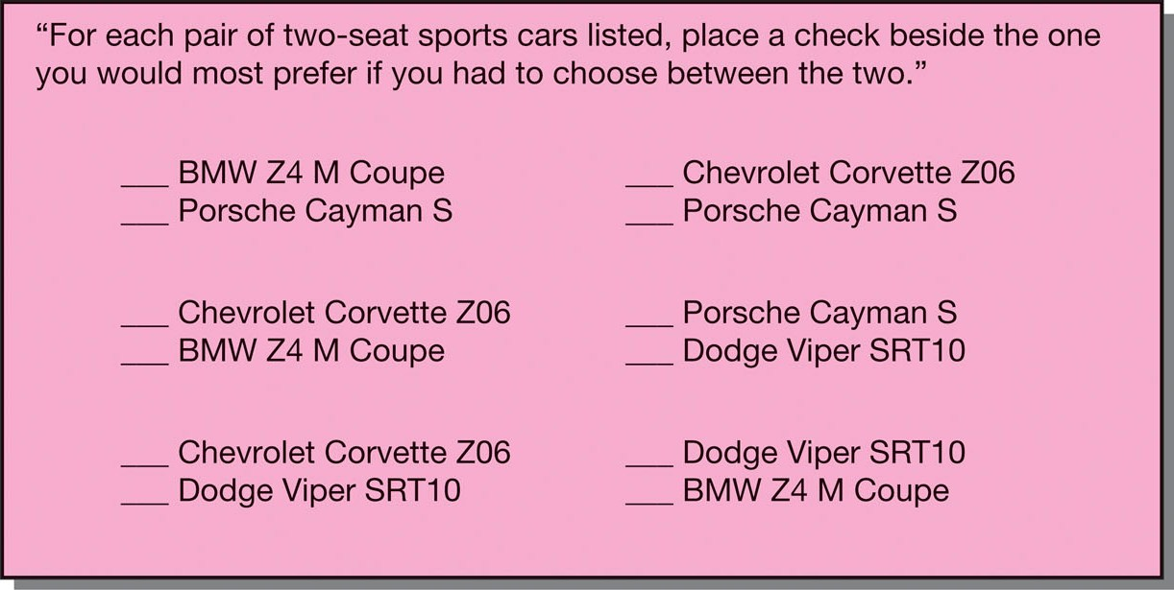
Paired-Comparison Scale

Slide 76

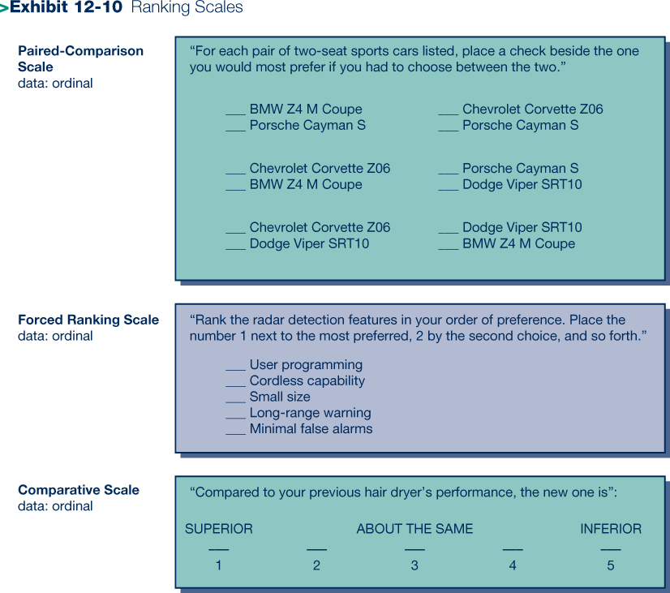
Forced Ranking Scale

Slide 77

Comparative Scale

Slide 78

MindWriter Scaling
Likert Scale
The problem that prompted service/repair was resolved
Strongly Disagree | Disagree | Neither Agree Nor Disagree | Agree | Strongly Agree
1 | 2 | 3 | 4 | 5
Numerical Scale (MindWriter’s Favorite)
To what extent are you satisfied that the problem that prompted service/repair was resolved?
Very Dissatisfied |  |  |  | Very Satisfied
1 | 2 | 3 | 4 | 5
Hybrid Expectation Scale
Resolution of the problem that prompted service/repair.
Met Few Expectations | Met Some Expectations | Met Most Expectations | Met All Expectations | Exceeded Expectations
1 | 2 | 3 | 4 | 5

